Slide 1
A Tour of Ranges in C++
Tom Peters, June 18, 2019
thomas.d.peters@gmail.com
tdp2110 on slack, github
@__tom_peters__
Notes:
Feel free to ask questions or interrupt.
Before we begin I wanted to mention I don't think this library is for everyone, and there's a little bit of controversy around it.
Don't think you're a bad programmer if you don't use this stuff, especially if you're a beginner.
That said, I find it useful, as do many others, and I find it interesting which is why I wanted to give a talk on it.

Slide 2
Outline
Introduction to ranges
Views
Actions
Algorithms
The dark side

Slide 3

range-v3
https://github.com/ericniebler/range-v3/
Work of Eric Niebler
C++ Standards committee member
Author of 4 boost libraries
Notes:
There are a few range libraries out there, including Boost.Range and Adobe Source Libraries.
We're mostly going to talk about Eric Niebler's Range-v3 library some of which is accepted for standardization in C++20,
And likely more of it in C++23. We're going to talk about the library itself, which many of you can use today, depending on your compiler. We won't talk too much about standardization.
The library depends on a few cutting-edge features of C++, including Concepts, and we'll talk about those as they come up.

Slide 4
What is a range?
Notes:
First things first ...

Slide 5
What is a range? (Version 1)
A range is something that can be put in a range-based for-loop:
Examples:
std::vector
std::array
std::set
std::string_view
for (auto&& elt : rng) { // do stuff with elt }
Notes:
Sting view and std::span are examples of views, these are ranges which don’t own their elements
So What makes it possible to put something in a range-based for?

Slide 6
What is a range (Version 2)
A range is something we can call std::begin and std::end, which return iterators.
Iterators are generalizations of pointers, having:
operator*()
operator++(), operator++(int)
for (auto it = std::begin(rng); it != std::end(rng); ++it) { // do stuff with it }
Notes:
Before C++11, instead of a range-based for, we might write something like the following (of course with no auto). In fact, a range-based for-loop is syntactic sugar for something similar to this
Anyone know what the deal is with operator++(int)?
Iterators are often objects, with dereference operator or increment operators doing interesting things. On a std::vector, an iterator is basically a pointer somewhere to its data segment, the ++ operator advancing the pointer. For std::map, which is implemented as balanced trees, operator++ bounces around in the tree in an in-order traversal.

Slide 7
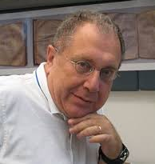
Iterators and the STL
std::vector<int> v = /* … */; std::sort(v.begin(), v.end()); auto it = std::find(v.begin(), v.end(), [](int elt) { return elt == 42; }); auto it = std::maximum_element(v.begin(), v.end());
Notes:
Iterators form the basis of Alexander Stepanov's STL algorithms.
Algorithms take iterators and return them, and this has been an immensely successful model.
While it's useful to be able to specify a pair of iterators in STL algorithms, most of the time we just put v.begin() and v.end()

Slide 8
Range-based algorithms
// using range-v3 library | // C++20
#include <range/v3/all.hpp> std::vector<int> vec = /*…*/; ranges::sort(vec); auto it = ranges::find( vec, predicate); | #include <ranges> std::vector<int> vec = /*…*/; std::ranges::sort(vec) auto it = std::ranges::find( vec, predicate);
Notes:
Ranges allow us to write algorithms that act on a single range. Note in C++20, we don't have std::sort on a range, we have a sub-namespace of std, std::ranges.
And that’s it, that’s all there is to ranges. Kidding ...
So this is nice, and reduces the chance of mismatched iterators, but it's not terribly interesting, it's really not enough for a whole talk.
Ranges really become interesting when we talk about range adaptors.

Slide 9
Composing STL algorithms is awkward
// given std::vector<int> v = {0,1,2,3,4,5,6,7,8,9}; // how to produce a vector consisting of the squares // of the even elements?

Slide 10
Composing STL algorithms is awkward
#include <algorithm> #include <vector> std::vector<int> v = {1,2,3,4,5}; std::vector<int> evens; std::copy_if(v.begin(), v.end(), std::back_inserter(evens), [](int elt) { return elt % 2 == 0; }); std::vector<int> res; std::transform(evens.begin(), evens.end(), std::back_inserter(res), [](int elt) { return elt * elt; });

Slide 11
Range version:
#include <vector> #include <range/v3/all.hpp> std::vector<int> v = {1,2,3,4,5}; auto rng = v | ranges::view::filter( [](int elt) { return elt % 2 == 0; }) | ranges::view::transform( [](int elt) { return elt * elt; });
Notes:
The pipe, the vertical bar, is inspired by the pipe operator on Unix -- it's a way of passing data to the right through various transformers, and is an elegant use of operator overloading.
This example isn't actually identical to the previous STL version. In particular, what is the type of rng?
I actually … don't know, it's actually something fairly complicated, but it doesn't really matter. What does matter, however, is that it is a range …
So we can iterate over it (eg, though a range-based for-loop)
So rng is a range, and this doesn’t mean rng is an instance of any particular class (eg with virtual functions). Ranges are a family of classes which all model a given Concept, giving a form of static polymorphism.
Note in the previous version, we had to allocate twice more to produce the final result. It turns out there's no (dynamic) allocation to produce rng -- it's traversing v in a different way (through filters and transforms). Rng is a particular kind of range called a view, which isn't a container. Constructing rng is O(1), and Iterating through it produces values lazily, on demand.
rng is a view, it's some iterable class, and does interesting things on iteration: when we call ++ on an iterator of it, the filter kicks in and skips elements until a predicate is satisfied. When we call operator*, the transform kicks in.
These operations only happen when we iterate, so additionally we say that range adaptors are lazy, like haskell lists.
The ranges library constructs these object though template metaprogramming
On construction of rng, no filtering or transforming happens -- it only happens if and when we iterate. There's also no memoization, so iterating again does the same work.
Whatever class rng has, it contains a couple of function objects and some kind of reference, or pointer, to a vector. You could write one by hand yourself, but the ranges library allows you to construct such views by composing some basis operations.
Filter and transform are examples of range adaptors

Slide 12
Range concepts
template<class T> concept bool Range = requires(T&& t) { { std::begin(t) } -> Iterator<T> { std::end(t) } -> Iterator<T> } } // see https://github.com/CaseyCarter/cmcstl2/ // for proper definitions | template<class T> concept bool View = Range<T> && Semiregular<T> && ViewPredicate<T>; // see https://en.cppreference.com/w/cpp/experimental/ranges/range/View
Notes:
Semiregular means copyable and default constructable. A Regular type is additionally equality comparable. Ranges, in general, are not equality comparable.
ViewPredicate is a heuristic that attempts to check that T is not container-like, ie that it doesn't own the elements it iterates over.
This means that views are cheap to copy, think O(1), and don't own the things they iterate over.
Ranges has a whole library of concepts of various kinds of concepts and iterators
Why would we use concepts instead of virtual interfaces?

Slide 13
Range concepts
template<class T> concept bool Range = requires(T&& t) { { std::begin(t) } -> Iterator<T> { std::end(t) } -> Iterator<T> } } template<class T> concept bool View = Range<T> && Semiregular<T> && ViewPredicate<T>; | template<class T> requires Range<T> void Foo(T&& t) { // ... }

Slide 14
What is a range (Version 3)
A range is something which models the Range concept.
template<class T> concept bool Range = requires(T&& t) { { std::begin(t) } -> Iterator<T> { std::end(t) } -> Iterator<T> } }

Slide 15
A few range adaptors
Notes:
We've seen a few range adaptors already, filter and transform, but range-v3 has a whole library of algorithms, many inspired by functional programming. Let's look at some more

Slide 16
Filter, transform
Filter. operator++ is interesting: skips until predicate is met
Transform. operator* is interesting: it applies a predicate (only when asked for)

Slide 17
Range adaptors: all
auto rng2 = rng1 | view::all;

Slide 18
Range adaptors: Concat
Join: traverse first range, then second range, then …
std::vector<int> v = {1,2,3,4}; std::set<int> s = {5,6,7,8,9}; auto rng = ranges::view::concat(v, s); // traversing yields 1,2,3,4, 5,6,7,8,9
Notes:
Join is variadic. Operator++ and operator* are interesting.

Slide 19
Range adaptors: take and slice
std::vector<int> v = {1,2,3,4,5,6,7,8,9,10};
auto first_five = v | ranges::view::take(5);
auto slice = v | ranges::view::slice(3,6);
Notes:
You might use slices for example if you were writing a quicsort

Slide 20
Range Adaptors: Join
Flatten a range of ranges to a single range:
std::vector<std::vector<int>> v = {{1,2}, {3,4,5}, {6,7,8,9}};
std::vector<int> flat = v | ranges::view::join;
// flat = {1,2,3,4,5,6,7,8,9};

Slide 21
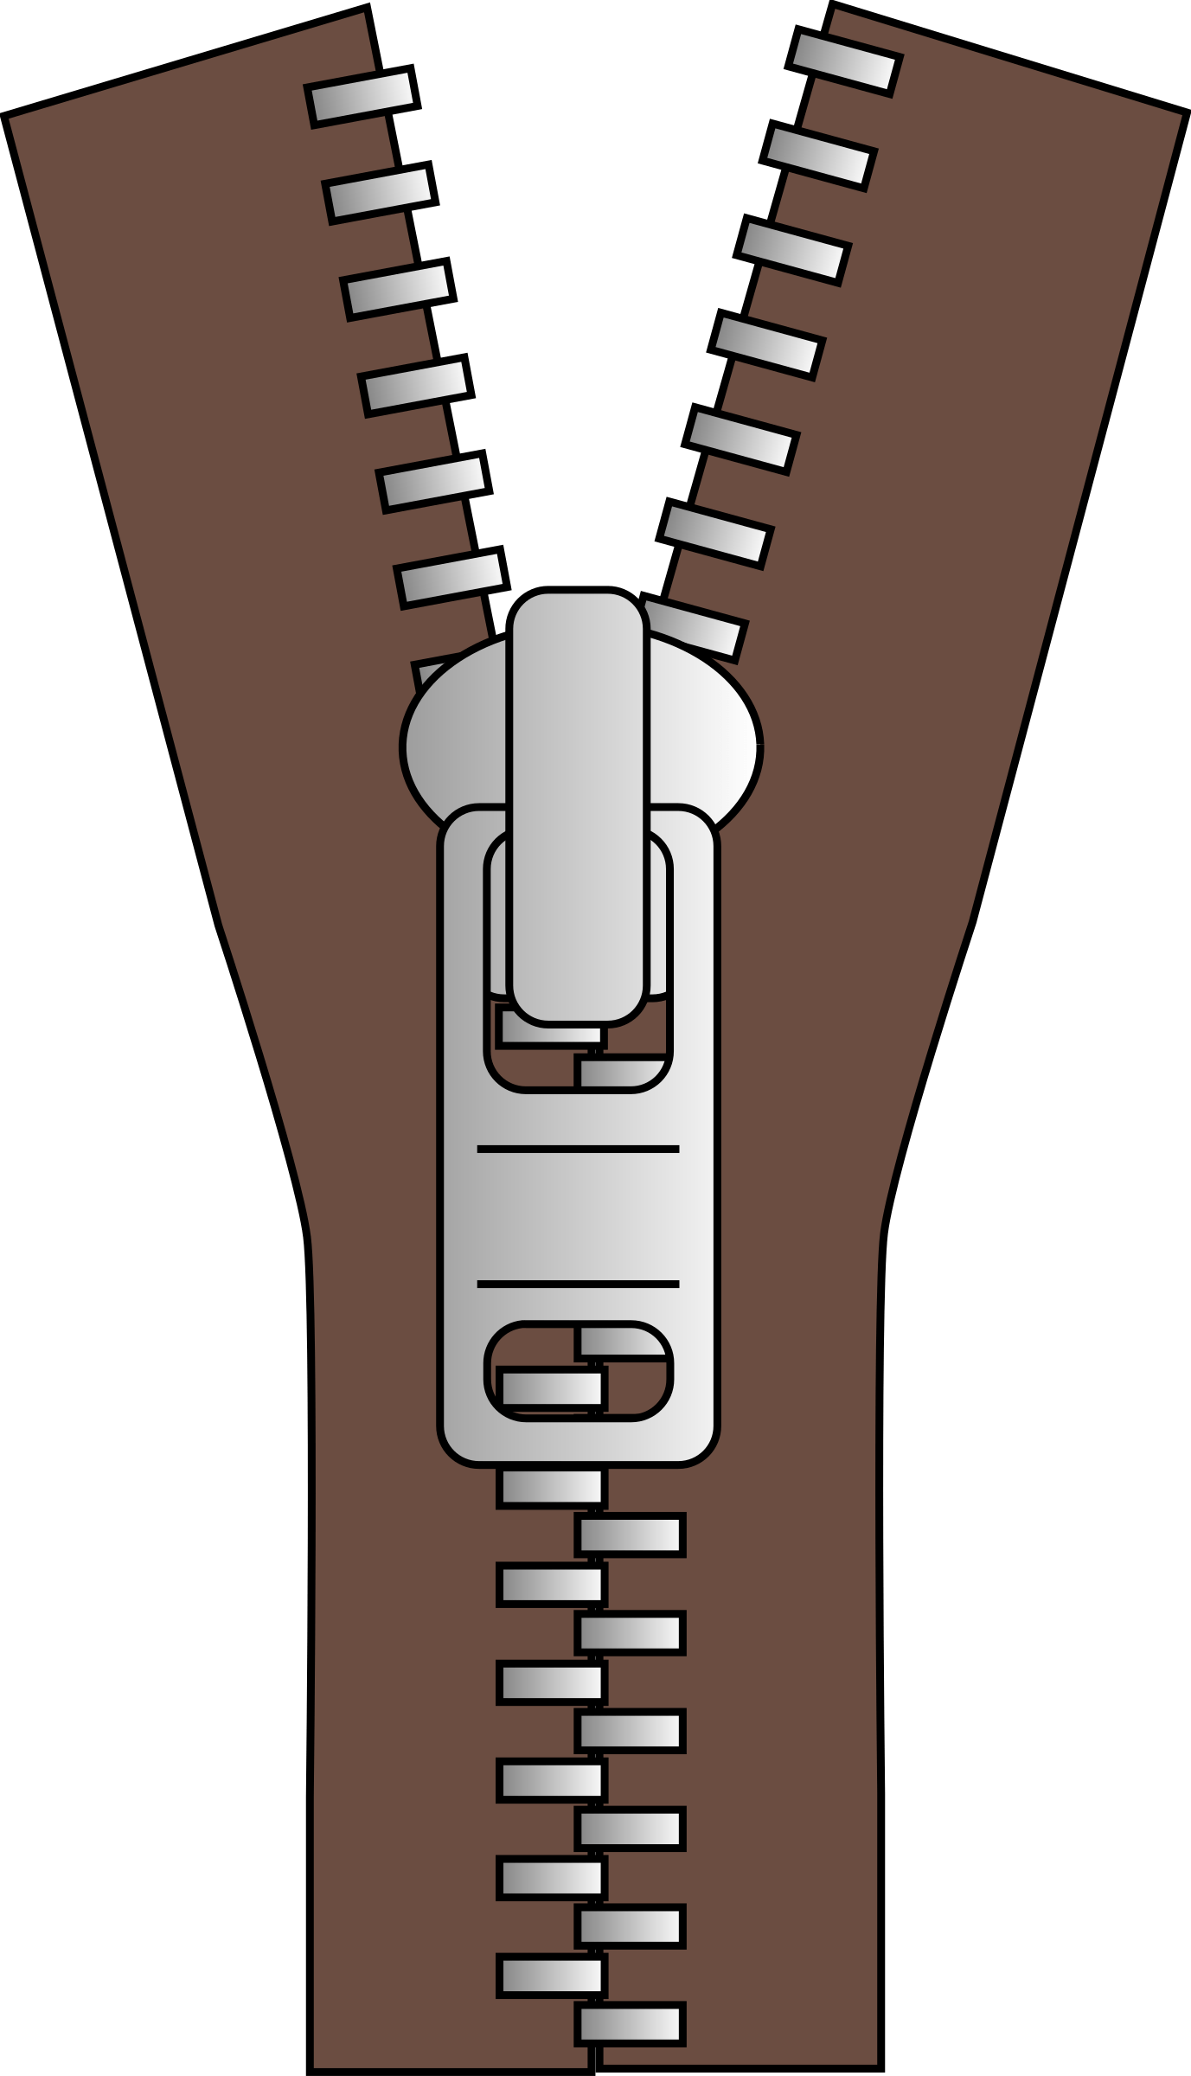
Zip
std::vector<int> v = {1,2,3,4};
std::set<int> s = {5,6,7,8,9};
auto rng = ranges::view::zip(v, s);
// traversal gives pairs of references:
// (1,5), (2,6), (3,7), (4,8)
http://ericniebler.com/2015/01/28/to-be-or-not-to-be-an-iterator/
https://ericniebler.github.io/std/wg21/D0022.html
Notes:
Zip may not be in C++20. The problem is it doesn't fit well into the current iterator model -- the value type doesn't refer to a real object, it's what's called a proxy iterator (vector<bool> has a similar problem). Maybe we'll get it in C++23

Slide 22
Enumerate
// range-v3 version std::set<std::string> s = {"hello", "world"}; for (auto const& [index, str] : ranges::view::enumerate(s)) { // do stuff } | // old style std::set<std::string> v = {"hello", "world"}; int index = 0; for (auto const& str : s) { // do stuff ++index; }
Notes:
Ever want to traverse a container keeping track of an index?
The ranges version is less error prone and, maybe more importantly, just directly says what it means.
Though it may take some getting used to.

Slide 23
Range generators
auto nats = ranges::view::ints();
// yields 0,1,2,3, …
// example, enumerate can be written:
auto enumerator = ranges::view::zip(ranges::view::ints(), someRng);
auto first_ten_ints = nats | ranges::view::take(10);
Notes:
Laziness gives an interesting property: ranges can be infinite, like haskell lists.
I said earlier that ranges need a begin and an end. The begin iterator is pretty simple: it just needs to hold a single int: dereferencing gives the int, operator++ increases the int. What about end? What is it?
It's just some object, a sentinel, which is never equal to any object of type begin returns. In fact, in range-v3 and the ranges TS, begin and end on a range are allowed to have different types, they just need to be equality comparable.

Slide 24
Range actions
Eager, mutating, composable algorithms
std::vector<T> v;
v = move(v) | action::sort | action::unique;
Notes:
An action is an eager application of an algorithm to a container that mutates the container in-place and returns it for further processing.
I'm not as familiar with these.

Slide 25
Range actions
adjacent_remove_if drop drop_while erase insert join remove remove_if reverse shuffle | slice sort split split_when stable_sort stride take take_while transform unique

Slide 26


Projections
struct Person { int id; }; std::vector<Person> v;
std::sort(v.begin(), v.end(), [](auto& p1, auto& p2) { return p1.id < p2.id; });
ranges::sort(v, std::less{}, [](auto& p) { return p.id; });
ranges::sort(v, std::less{}, &Person::id);
Notes:
A projection is a unary transformation function passed to an algorithm that gets applied to each element before the algorithm operates on the element.
The second form here uses a projection as a key function to sort.

Slide 27
Projections && std::invoke
struct Person { int id; };
What is &Person::id??
Pointer to member data: type int Person::* May be called dynamically: Person p {42}; int Person::* memberDataPtr = &Person::id; assert(p.id == p.*memberDataPtr); assert(p.id == std::invoke(memberDataPtr, p)); assert(p.id == std::invoke([](Person& p) { return p.id; }, p));
Instead of f(args…), range-v3 uses the more general std::invoke(f, args…)
Notes:
Std::invoke, from C++17, knows how to uniformly call generalized callables on variadic arguments. So in the generic programming for range-v3, instead of writing things like f(args…), it uses the more general

Slide 28

But wait, there's more!
Templates for generating views!
Templates for generating adaptors!
(Work in progress) asynchronous ranges!

Slide 29
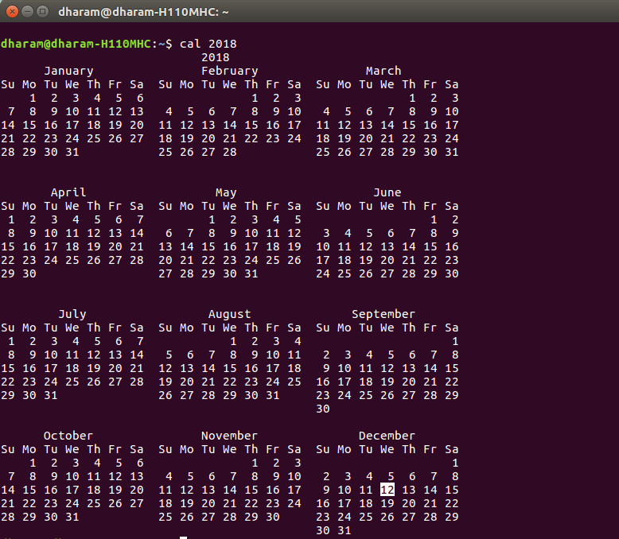


Slide 30
Compiler support
From https://ericniebler.github.io/range-v3/
clang 3.6.2
GCC 4.9.1
MSVC VS2017 15.9 (_MSC_VER >= 1916), with /std:c++17 /permissive-
Notes:
/permissive- permits MSVC to follow the strict standard
For a long time, this code couldn't compile at all on Microsoft, but I think last fall they got it going in MSVC 2017

Slide 31
Requirements
Requires C++11/14/17
pre-C++17, can't use range-based for on all ranges, need RANGES_FOR macro.
Notes:
Possibly dropping C++11 as well

Slide 32
Downsides of ranges
Notes:
I want to talk about a few of the dark sides of ranges. Around the end of last year, Eric Niebler posted a blog post celebrating ranges acceptance into C++20, and I don't know if it was the joy of the holidays, but the post received a fair amount of strong and negative response, often from "angry game devs." There were some good points raised in all of this, and we'll get to them in a minute, but I'll start with a few complaints not brought up by that crowd.

Slide 33
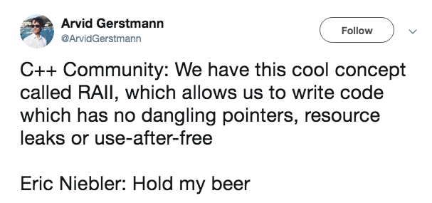
Ownership
Notes:
Recall that views are not container like, and thus don't often own the data they're iterating over.
We have no garbage collector or borrow checker, and just like pointers and iterators, we have to be very careful about use-after-free and use-after-scope

Slide 34
Ownership 2
auto rng = std::vector<int>{1,2,3} | ranges::view::reverse;
error: static assertion failed: You can't pipe an rvalue container into a view. First, save the container into a named variable, and then pipe it to the view. static_assert(ranges::View<Rng>() || std::is_lvalue_reference<Rng>(), ~~~~~~~~~~~^~~~~~~~~~~~~~~~~~~~~~~~~
Notes:
What happens here?
This error can be detected statically, so there is some protection.
Note that adapting an r-value view is oerfectly fine, as it’s assumed to be referring to data with valid lifetime
But we're not completely safe ...

Slide 35
Ownership 3
auto Oops() { std::vector<int> v{1,2,3,4}; return v | ranges::view::reverse; } int main() { for (auto elt : Oops()) { // use after free! // whatever } }
Notes:
Oops compiles just fine. It's basically impossible to use without UB. This is just as bad as returning the address of v.

Slide 36

ICE
fatal error C1001: An internal error has occurred in the compiler.
Notes:
Get ready for internal compiler errors

Slide 37
A few more of my complaints:
No view to const
Creating custom ranges/views is tedious
Error messages can be bad.
Notes:
Unlike pointers, spans, or even string_view, there's no such thing as a view-to-const
Error message might say: type failed to model a concept, but it doesn't say why not. Maybe this will change with a real concepts-based implementation.

Slide 38

"Modern" C++ lamentations
https://aras-p.info/blog/2018/12/28/Modern-C-Lamentations/

Slide 39
Pythagorean Triples
A triple of integers (a,b,c) such that a^2 + b^2 = c^2.
Examples:
(3, 4, 5): 3^2 + 4^2 = 5^2
(5,12,13): 5^2 + 12^2 = 13^2
Notes:
There are infinitely many pythagorean triples, and it's an interesting problem to try to generate them all.

Slide 40
Pythagorean Triples
Printing the first n:
void printNTriples(int n) { int i = 0; for (int z = 1; ; ++z) for (int x = 1; x <= z; ++x) for (int y = x; y <= z; ++y) if (x*x + y*y == z*z) { printf("%d, %d, %d\n", x, y, z); if (++i == n) return; } }
Notes:
If we want to print the first n, we can write a fairly straightforward bit of code here with triple nested loops.
Problems come when we want to do something other than print … you can abstract the operation, and pass in a callback ... you could also create a custom iterator that maintains state, eg using a view_facade
but another approach is to separate the triples from the algorithm operating on them, and that's where lazy evaluation, in particular ranges, help.

Slide 41
Pythagorean triples, lazily
From http://ericniebler.com/2018/12/05/standard-ranges/
auto triples = for_each(iota(1), [](int z) { return for_each(iota(1, z+1), [=](int x) { return for_each(iota(x, z+1), [=](int y) { return yield_if(x*x + y*y == z*z, make_tuple(x, y, z)); }); }); });
Notes:
Before we try to make sense of this, this brings up one downside: range code can be hard to read.

Slide 42
Pythagorean triples, lazily
From http://ericniebler.com/2018/12/05/standard-ranges/
auto triples = for_each(iota(1), [](int z) { return for_each(iota(1, z+1), [=](int x) { return for_each(iota(x, z+1), [=](int y) { return yield_if(x*x + y*y == z*z, make_tuple(x, y, z)); }); }); });
for_each(rng, f) <=> rng | transform(f) | join;
Notes:
Don't feel bad if this isn't obvious … it's pretty universally been considered hard to understand, which brings us to the first gamedev lamentation: range code is sometimes hard to understand.
I don't want to go into too much detail, but let's try to understand this a little. You kind of have to read it inside out

Slide 43
Pythagorean triples, lazily
From http://ericniebler.com/2018/12/05/standard-ranges/
auto triples = for_each(iota(1), [](int z) { return for_each(iota(1, z+1), [=](int x) { return for_each(iota(x, z+1), [=](int y) { return yield_if(x*x + y*y == z*z, make_tuple(x, y, z)); }); }); }); | -- Haskell triples :: [(Int, Int, Int)] triples = [(x, y, z) | z <- [0..] , x <- [1..z] , y <- [x..z] , x * x + y * y == z * z ]
for_each(rng, f) = rng | transform(f) | join;
Notes:
Transform followed by join is also known as … flatMap in some languages, or bind in others. monadic bind. Haskell has syntactic sugar for sequences of binds, called do notation, and a further sugar for the list monad, called list comprehensions:

Slide 44
Pythagorean triples
auto triples = for_each(iota(1), [](int z) { return for_each(iota(1, z+1), [=](int x) { return for_each(iota(x, z+1), [=](int y) { return yield_if(x*x + y*y == z*z, make_tuple(x, y, z)); }); }); }); for (auto elt: triples | ranges::view::take(100)) { std::cout << elt << "\n"; } | void printNTriples(int n) { int i = 0; for (int z = 1; ; ++z) for (int x = 1; x <= z; ++x) for (int y = x; y <= z; ++y) if (x*x + y*y == z*z) { printf("%d, %d, %d\n", x, y, z); if (++i == n) return; } } printNTriples(100);
Compile time: ~3 sec Runtime (debug): 300ms (0.3s) Runtime (release): 1ms | 0.064 sec 2ms 0ms
Notes:
Let's compare the CS 101 version with the range-version.
Compile times with range-v3 are quite high, and this is because it's a huge header-only TMP library.
Debug performance is also way off from release perf
In this example, you can see the 3 main "gamedev lamentations":
"Modern" C++ is not necessarily readable
Compile times are out of control
Debug perf isn't a priority.
I would like to point out that the release performance of the range version is actually really good, and this is a testament to how good optimizing compilers are. Remember: with ranges, everything is statically bound, and a good compiler can really go to town on them. But it's also a testament to Eric and Casey's work on this library to make sure everything is performant as can be.

Slide 45
Coroutines
#include <cppcoro/generator.hpp> #include <tuple> cppcoro::generator<std::tuple<int,int,int>> triples() { for (int z = 1; ; ++z) for (int x = 1; x <= z; ++x) for (int y = x; y <= z; ++y) if (x*x + y*y == z*z) { co_yield std::make_tuple(x,y,z); } }
Notes:
There's another way to generate pythagorean triples, and that's from using coroutines (C++20).
Ranges and coroutines, which are coming in C++20, play very well together.
Although we can construct some custom ranges and views using classes in range-v3, it's not always super convenient.
I'm not so familiar with coroutines, or the cppcoro library, but unlike the previous monadic version, this may need a dynamic allocation.
The interaction of coroutines and ranges goes deeper: they're working on async ranges, and async transformers, which would be pretty rad.

Slide 46
Conclusions
Ranges give new primitives to more directly state intent.
But they come with a cost: compile times and debug perf.

